Slide 1
Kalman’s Beautiful Filter
(an introduction)
George Kantor
presented to
Sensor Based Planning Lab
Carnegie Mellon University
December 8, 2000

Slide 2
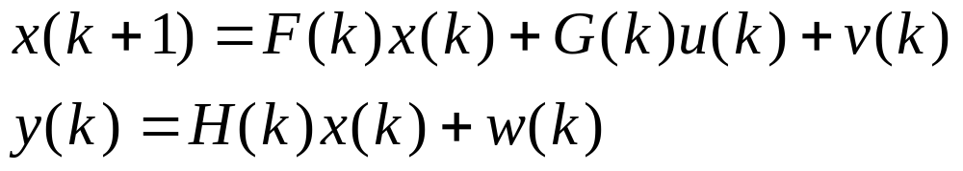
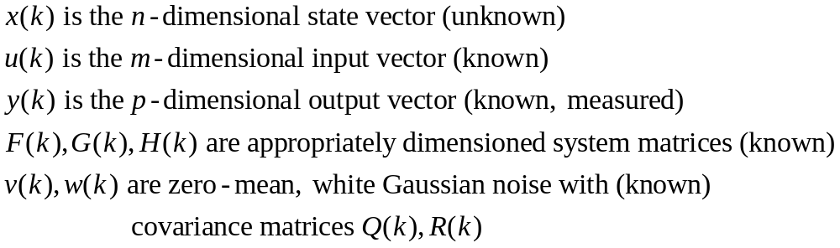
What does a Kalman Filter do, anyway?
Given the linear dynamical system:
the Kalman Filter is a recursion that provides the
“best” estimate of the state vector x.

Slide 3
What’s so great about that?
noise smoothing (improve noisy measurements)
state estimation (for state feedback)
recursive (computes next estimate using only most recent measurement)

Slide 4
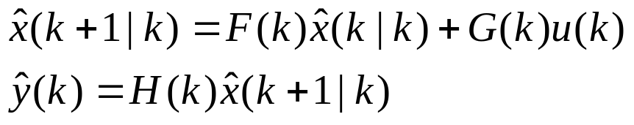


How does it work?
1. prediction based on last estimate:
2. calculate correction based on prediction and current measurement:
3. update prediction:

Slide 5

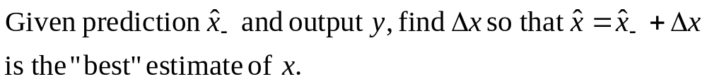



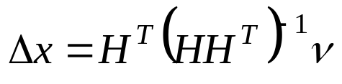
Finding the correction (no noise!)

Slide 6

A Geometric Interpretation

Slide 7
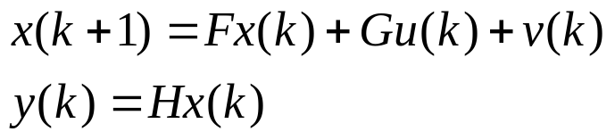

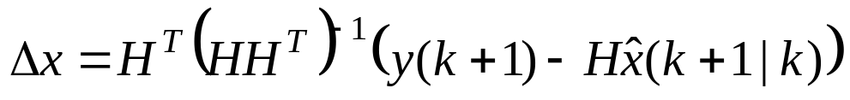
A Simple State Observer
System:
1. prediction:
2. compute correction:
Observer:
3. update:

Slide 8
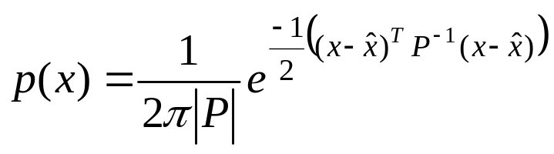

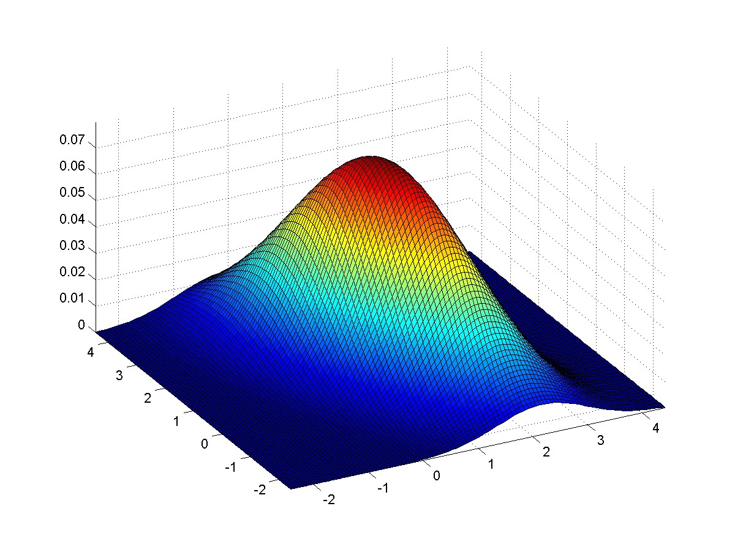
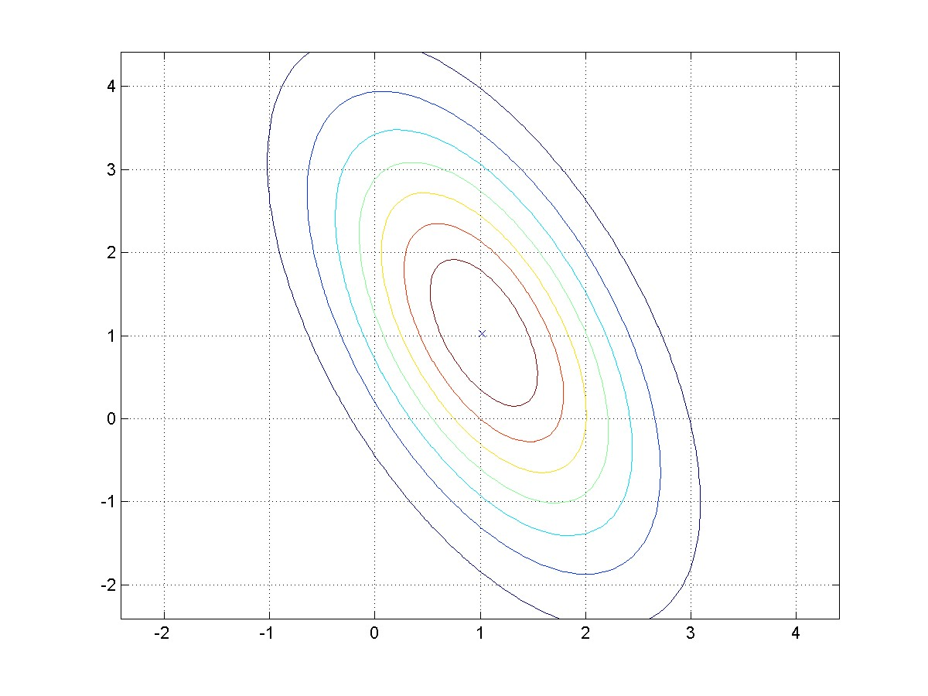
Estimating a distribution for x
Our estimate of x is not exact!
We can do better by estimating a joint Gaussian distribution p(x).
where is the covariance matrix

Slide 9
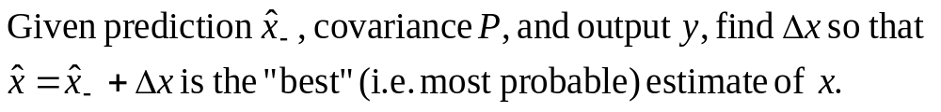
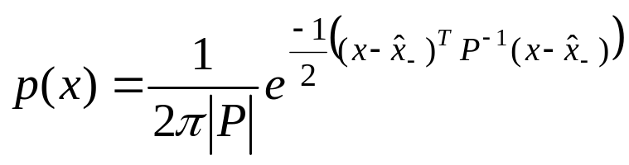
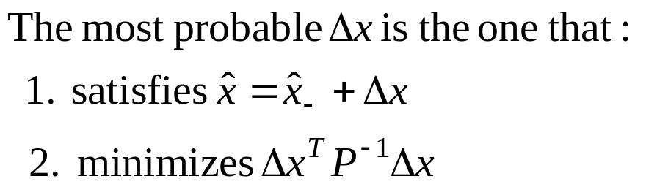
Finding the correction (geometric intuition)

Slide 10
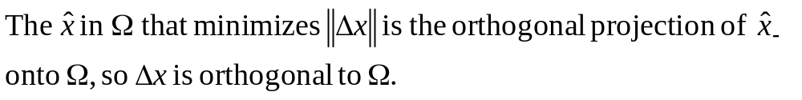

A new kind of distance

Slide 11



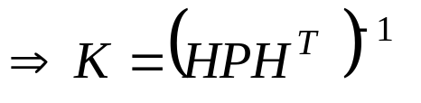
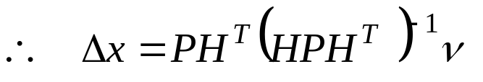
Finding the correction (for real this time!)

Slide 12
A Better State Observer
We can create a better state observer following the same 3. steps, but now we
must also estimate the covariance matrix P.
We start with x(k|k) and P(k|k)
Step 1: Prediction
What about P? From the definition:
and

Slide 13

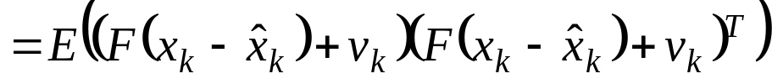
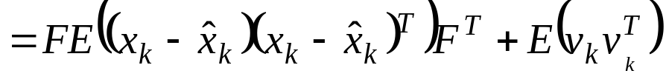


Continuing Step 1
To make life a little easier, lets shift notation slightly:

Slide 14


Step 2: Computing the correction
For ease of notation, define W so that

Slide 15

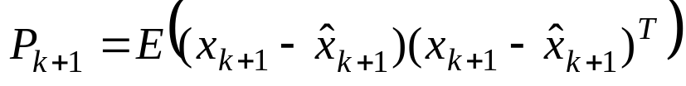
Step 3: Update
(just take my word for it…)

Slide 16

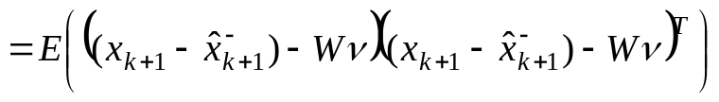

Just take my word for it…

Slide 17
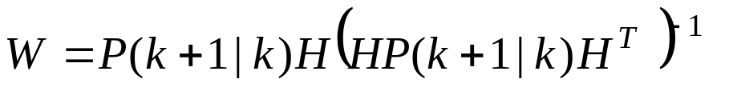

Better State Observer Summary
System:
1. Predict
Observer
2. Correction
3. Update

Slide 18

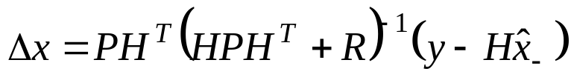
Finding the correction (with output noise)
Since you don’t have a hyperplane to
aim for, you can’t solve this with algebra!
You have to solve an optimization problem.
That’s exactly what Kalman did!
Here’s his answer:

Slide 19
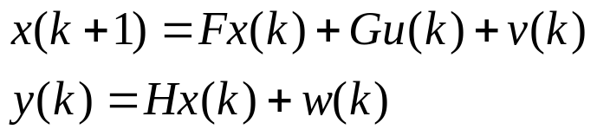



LTI Kalman Filter Summary
System:
1. Predict
Kalman Filter
2. Correction
3. Update

